Slide 1
C goto, continue, break statement
~ Madhav Shah

Slide 2

Defination
GOTO STATEMENT
The goto statement is a jump statement which is sometimes also referred to as unconditional jump statement. The goto statement can be used to jump from anywhere to anywhere within a function.

Slide 3
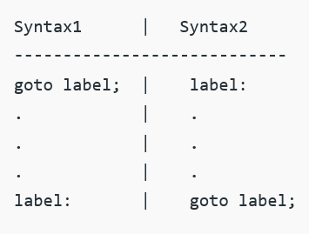
—Syntax
Forward Jump
Backward Jump

Slide 4
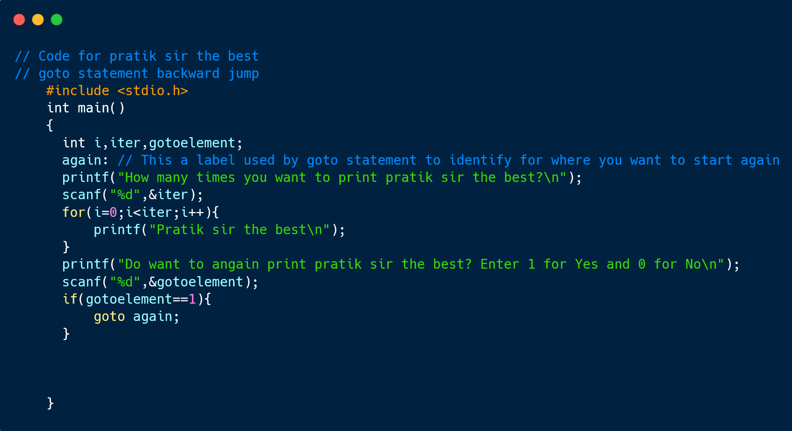
goto example (Backward Jump)

Slide 5
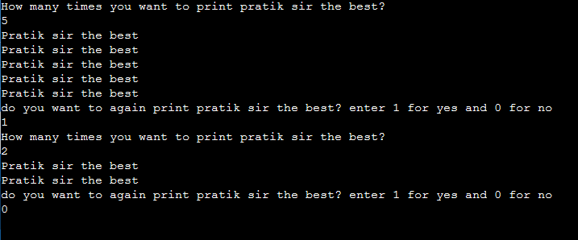
Output

Slide 6
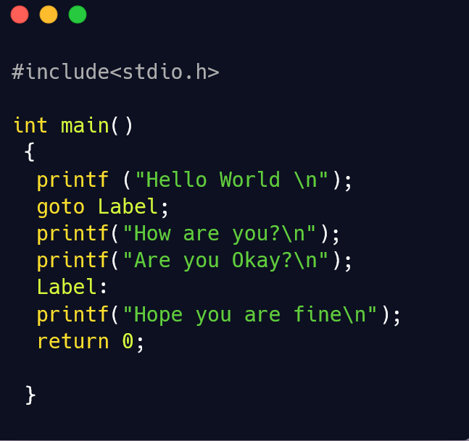
goto example (Forward Jump)

Slide 7

Output

Slide 8
Advantage:
using goto statement you can alter the normal sequence of the program execution so it gives the power to jump to any part of program.
Disadvantages:
It is always recommended not to use goto statement as this reduces the readability of the program.
It becomes difficult to trace the control flow of a program, making the program logic complex to understand.

Slide 9
Defination
BREAK STATEMENT
The break is a keyword in C which is used to bring the program control out of the loop. The break statement is used inside loops or switch statement. The break statement breaks the loop one by one, i.e., in the case of nested loops, it breaks the inner loop first and then proceeds to outer loops. The break statement in C can be used in the following two scenarios:

Slide 10

—Syntax

Slide 11
Break example
#include<stdio.h>
#include<stdlib.h>
void main ()
{
int i;
for(i = 0; i<10; i++)
{
printf("%d ",i);
if(i == 5)
break;
}
printf("came outside of loop i = %d",i);
}

Slide 12
Output

Slide 13
Defination
CONTINUE STATEMENT
Continue is also a loop control statement just like the break statement. continue statement is opposite to that of break statement, instead of terminating the loop, it forces to execute the next iteration of the loop.

Slide 14

—Syntax

Slide 15
Continue example
int main() {
// loop from 1 to 10
for (int i = 1; i <= 10; i++) {
// If i is equals to 6,
// continue to next iteration
// without printing
if (i == 6)
continue;
else
// otherwise print the value of i
printf("%d ", i);
}
return 0;
}

Slide 16

Output

Slide 17

THANKS!

Slide 18



Happy Birthday Pratik Sir 👍
🎉

